Slide 1


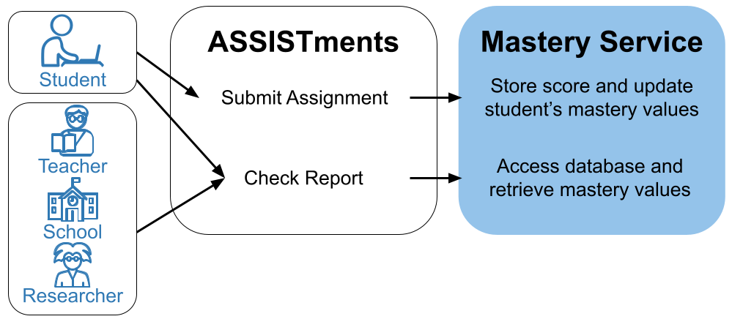
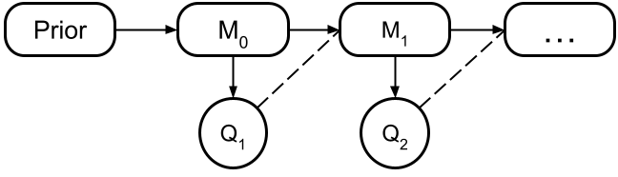
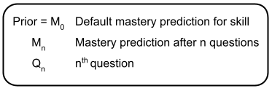
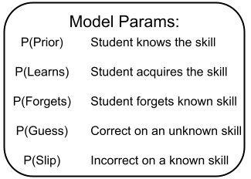
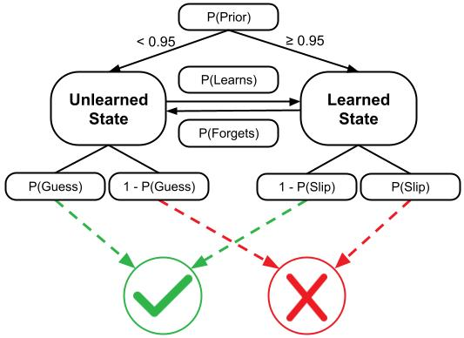
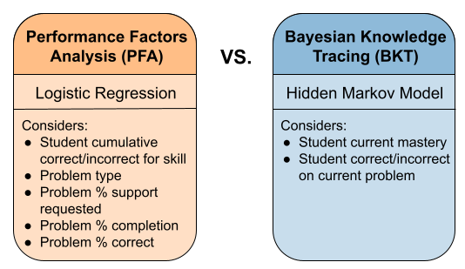
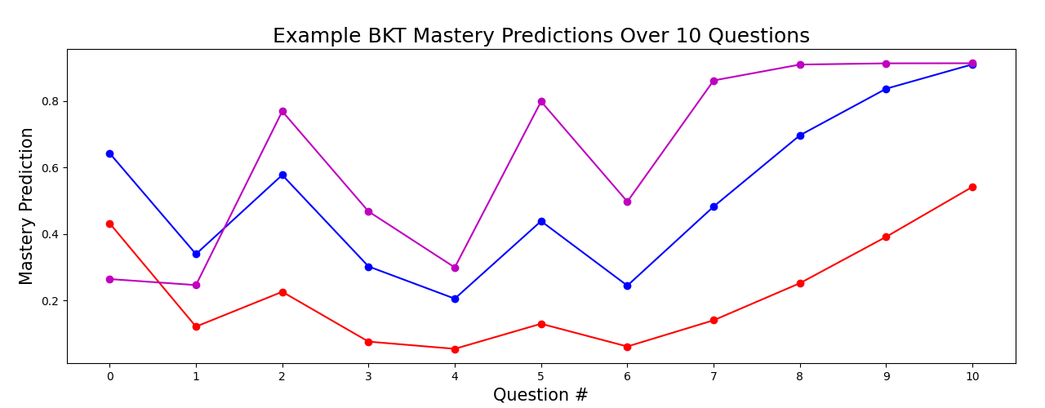

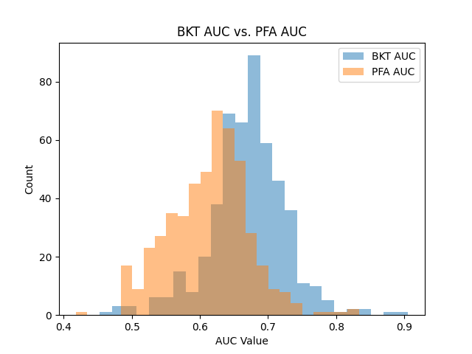
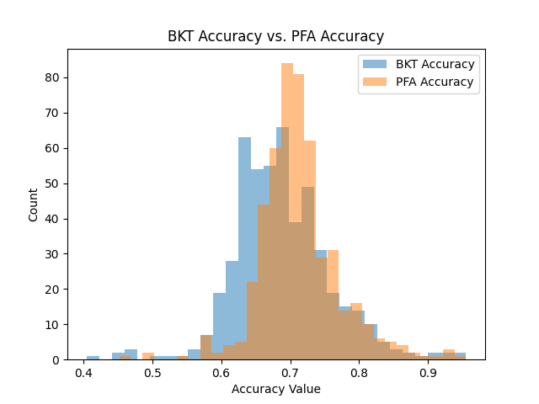
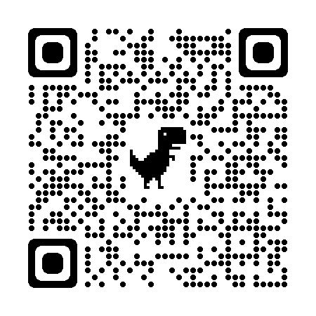

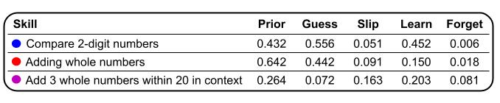
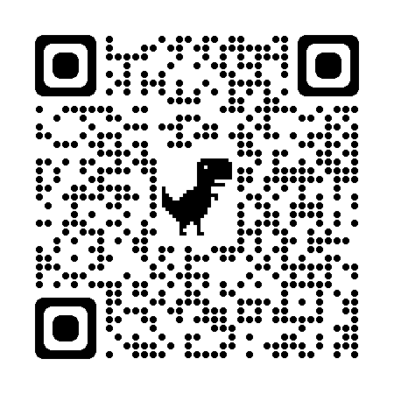
Developing a Mastery Learning Service for ASSISTments
Obie Kahne (Colorado College), Hector A. Rodriguez (University of Denver), Shailen Smith (Stony Brook University)
Background
Knowledge tracing, the practice of modeling and predicting student knowledge over time, has many applications for intelligent tutoring systems like ASSISTments. Our goal is to enable customized learning for students and provide data-driven insights for teachers, schools, and researchers by implementing a mastery learning service that tracks and predicts student knowledge in real time.
Data Gathering
ASSISTments problem logs since June 2022 (~14m rows)
Maximum first 100 logs for each student on a single skill
Discard students w/ only one log on a skill from train set [2]
70/30 train/test split such that no students are in both sets
BKT Architecture
Use Case Flow
How the BKT mastery prediction is updated after a question
----------------------------------------------------------------------
Model Comparison
Discussion
BKT model outperforms PFA model
Other BKT studies have better-performing models [1, 2]
Exclusion of some skills with inaccurate models
BKT model improves as student does more problems
Development of API vs. how the API is used
Next Steps
Integrate mastery service into the ASSISTments platform
Fix some issues with pyBKT Python library [1]
Develop an error metric for reliability of BKT
Compare to other knowledge tracing models including Factorization Machines and Deep Neural Networks
How BKT models a student applying their knowledge on a single question
----------------------------------------------------------------------
-------------------------------------------------------------------
How BKT mastery predictions change over 10 questions for three skills
Try a BKT simulation!
Acknowledgments: We thank Morgan Lee for their continuous mentorship and guidance. We extend our gratitude to Dr. Ethan Prihar, Aaron Haim, Dr. Neil Heffernan, Angela Kao, and everyone from the LS&T Department for their support and guidance as well as Dr. Catherine Yeh and Dr. Iris Howley for their BKT simulation which was useful for testing and inspired our poster design. Dr. Heffernan and his team wish to thank the NSF (e.g., 2118725, 2118904, 1950683, 1917808, 1931523, 1940236, 1917713, 1903304, 1822830, 1759229, 1724889, 1636782, & 1535428), IES (e.g., R305N210049, R305D210031, R305A170137, R305A170243, R305A180401, & R305A120125), GAANN (e.g., P200A180088 & P200A150306 ), EIR (U411B190024), ONR (N00014-18-1-2768 ) and Schmidt Futures. None of the opinions expressed here are that of the funders.
References: [1] Badrinath, A., Wang, F., Pardos, Z.A. (2021) pyBKT: An Accessible Python Library of Bayesian Knowledge Tracing Models. In S. Hsiao, & S. Sahebi (Eds.) Proceedings of the 14th International Conference on Educational Data Mining (EDM). Pages 468-474.
[2] C. Piech et al. Deep knowledge tracing. In C. Cortes, N. D. Lawrence, D. D. Lee, M. Sugiyama, and R. Garnett, editors, Advances in Neural Information Processing Systems 28, pages 505–513. Curran Associates, Inc., 2015.
[3] Pavlik Jr, P. I., Cen, H., & Koedinger, K. R. (2009). Performance Factors Analysis--A New Alternative to Knowledge Tracing. Online Submission.
Notes:
Yes, it’s already 36 x 24 in
We started with ASSISTments problem logs from all computer graded questions attempted by students since June 2022. We kept only the first 100 logs for a student on a single skill and removed all instances where a student attempted a skill only once.
BKT model that understands concept of learning something after every interaction (slipping and guessing) whereas PFA soley counts the number of success and failures without understanding the complexity of learning

